Slide 1

New tricks, old tricks, gold bricks:
A glance at the landscape of cryptocurrency fraud
Josh Kamps
MSc. Crime Science Student
Department of Security and Crime Science
University College London

Slide 2
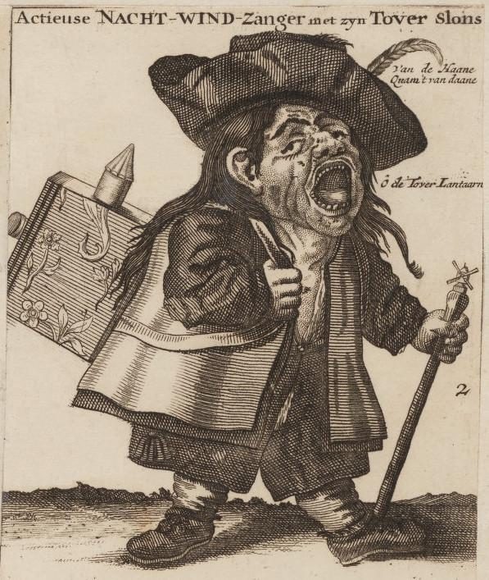
The Night Singer

Slide 3
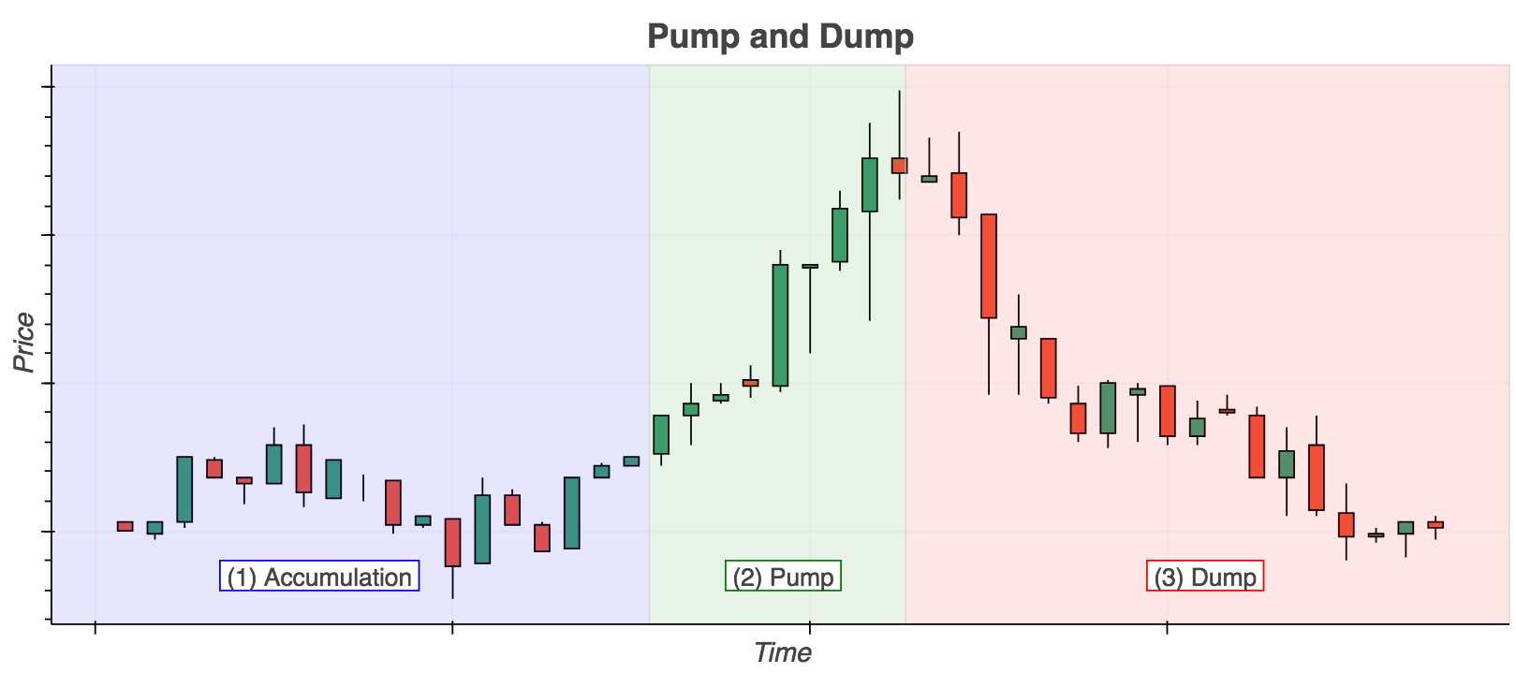
Anatomy of a P&D
The three phases of a pump-and-dump.
(Kamps & Kleinberg, 2018)

Slide 4
Pump-and-Dumps
The renaissance of this old trick has two drivers:
1. The Internet
2. Cryptocurrencies
Notes:
Penny stocks
Crypto P&Ds

Slide 5
Convergence of Events
The recent explosion of nearly 2,000 cryptocurrencies in a largely unregulated environment has greatly expanded the scope for abuse.
Internet
Real time secure communication
Lack of regulation
Cryptocurrencies
Decentralisation
(Hamrick et al., 2018)
Notes:
You expand the scope for abuse in ways people may not have thought of before

Slide 6
The story of
@OfficialMcafee and @OfficiallMcafee
From: Mac & Lytvynenko, Buzzfeed, 2018
Notes:
McAfee

Slide 7
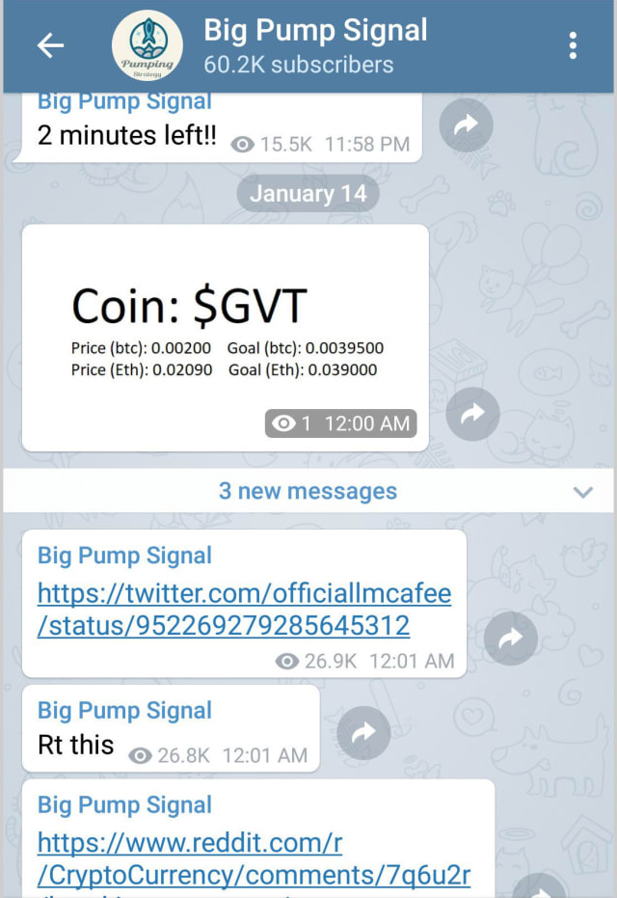
Notes:
McAfee

Slide 8
3:00 →The tweet is made and the market price of GVT is $30
(times are in ET)
Notes:
McAfee

Slide 9
3:00 →The tweet is made and the market price of GVT is $30
3:04 → The price of GVT has rocketed to $45, trading volume has doubled
(times are in ET)
Notes:
McAfee

Slide 10
3:00 →The tweet is made and the market price of GVT is $30
3:04 → The price of GVT has rocketed to $45, trading volume has doubled
3:19 → The price of GVT has fallen back to $30
(times are in ET)
Notes:
McAfee

Slide 11
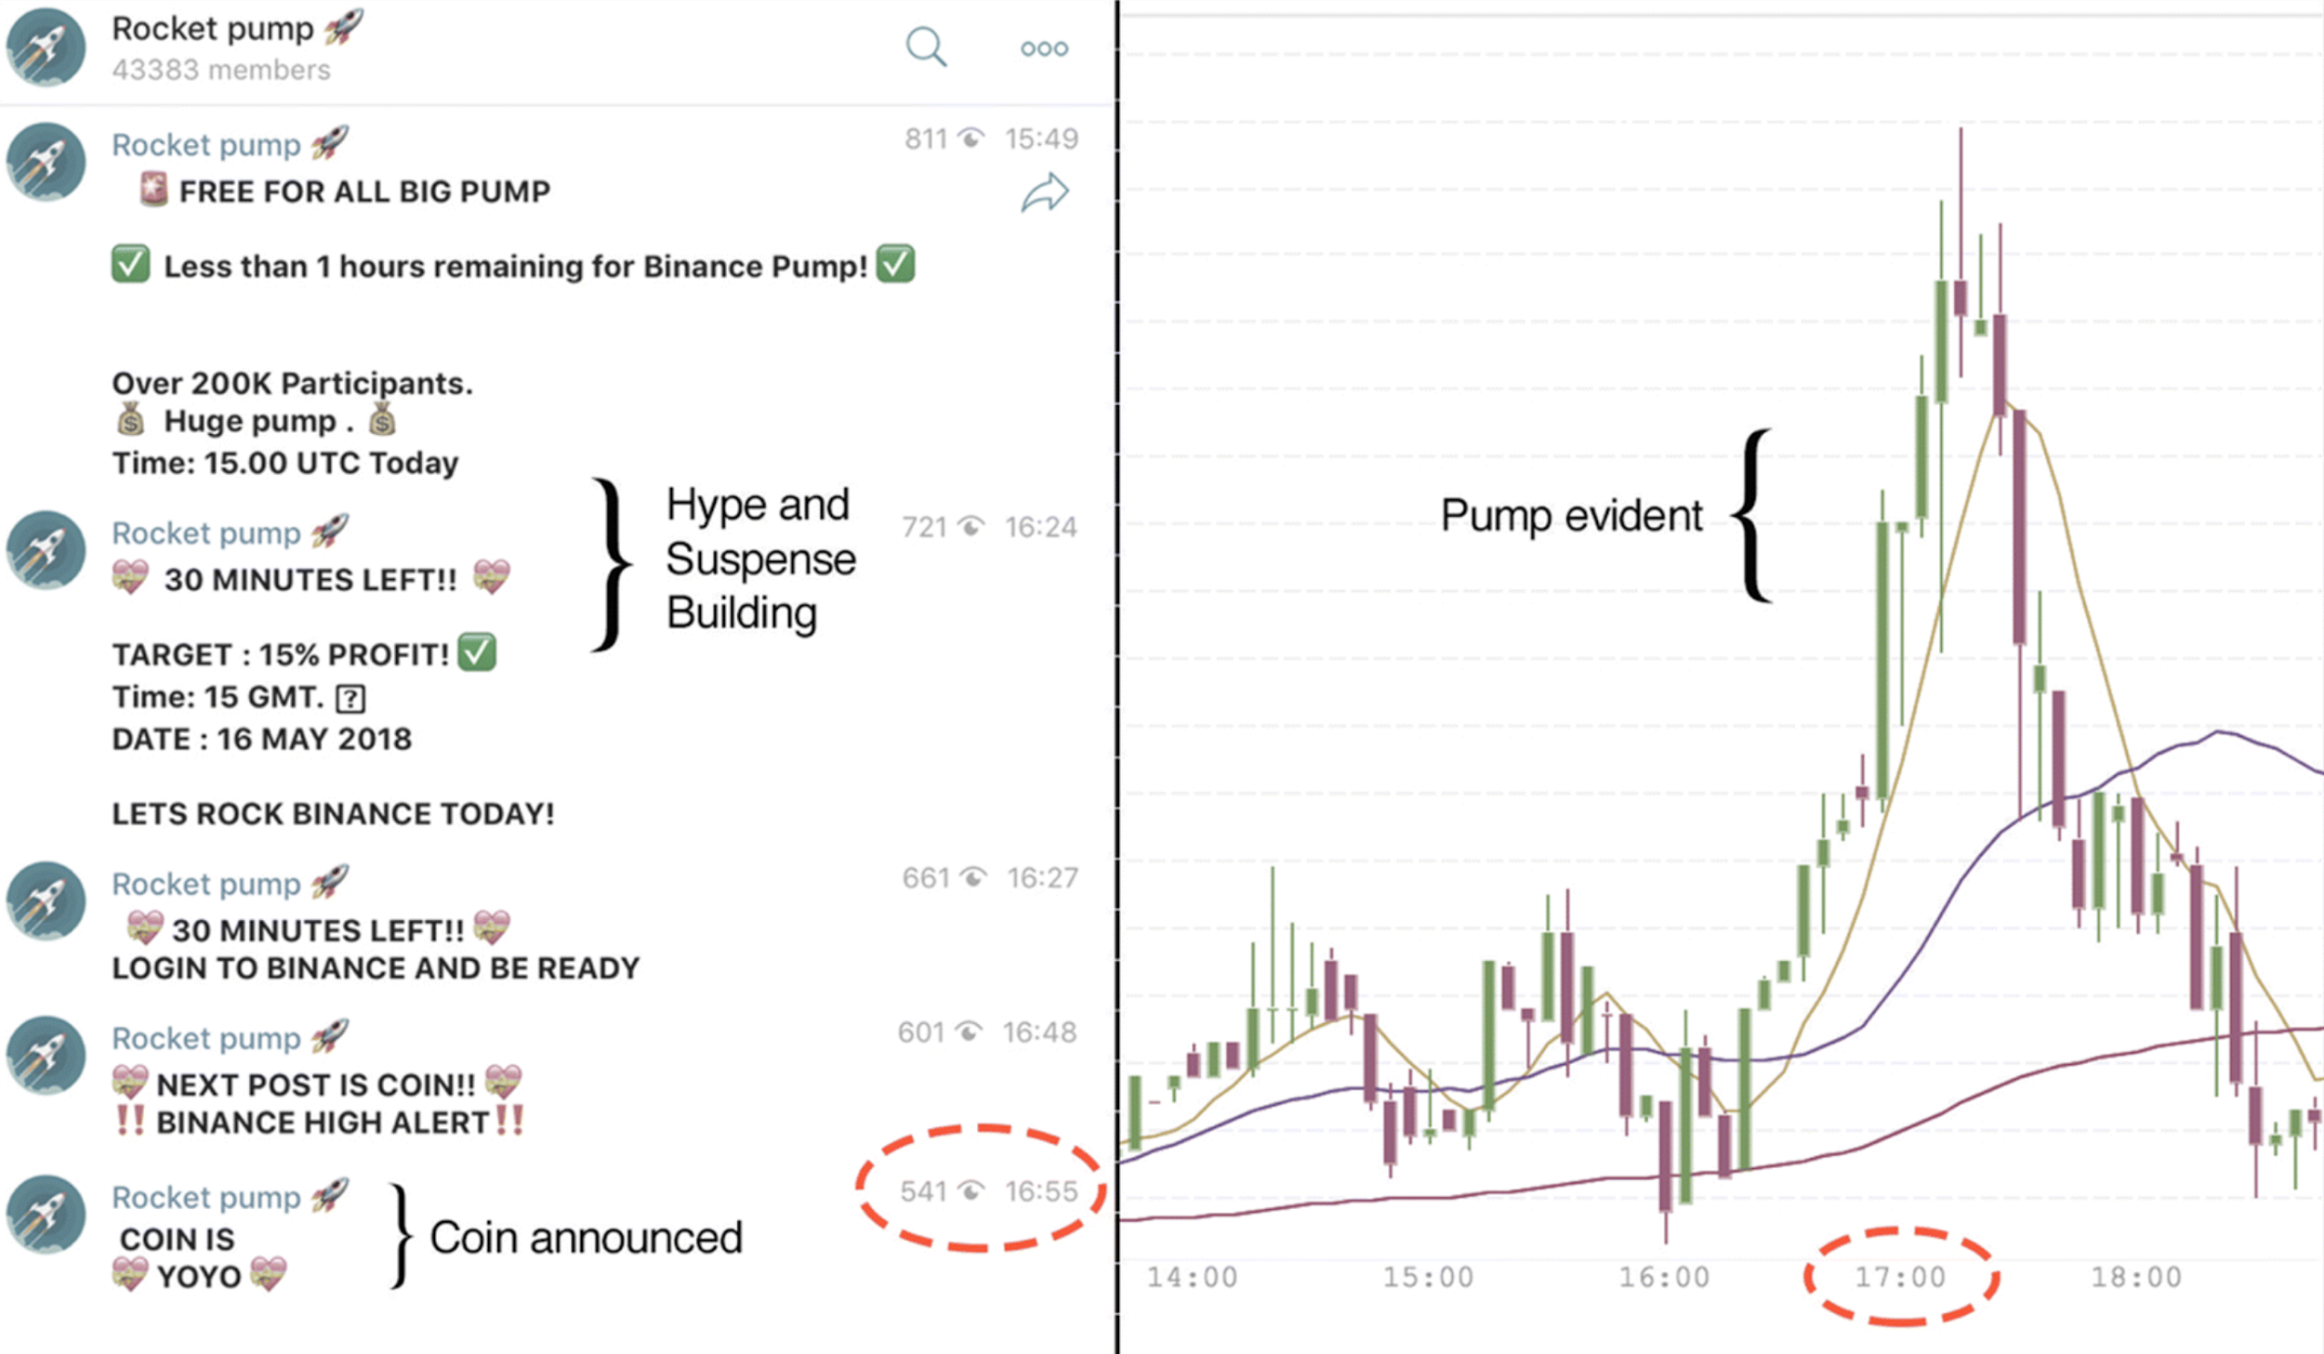
Another example

Slide 12
Takeaway
The smart money — the early money — had gotten out, leaving the late money holding a bag of now-diminished value.
Notes:
You’ll notice in the McAfee example, the whole affair only lasted about 20 minutes, something which is not unique to just this example.
You’ll also notice that the group organised themselves in an online chatroom, which adds to the real-time nature of the events.

Slide 13
Crypto P&Ds
Common Targets:
Low market cap
Low price
Low volume
Lack of reliable information
 | Traditional P&D | Crypto P&D
Tactic | Misinformation Privately organised (smaller scale) | Real-time misinformation Public or private group scams (larger scale)
Timescale | Medium (days to weeks) | Short (minutes to hours)
Notes:
You’ll notice in the McAfee example, the whole affair only lasted about 20 minutes, something which is not unique to just this example.
You’ll also notice that the group organised themselves in an online chatroom, which adds to the real-time nature of the events.

Slide 14
Why care?
Money.
Price increases of up to 950% have been witnessed
$825 million in illicit activity over a 6 month period in 2018
$222 million attributed to one group
Source: Shane Shifflet and Paul Vigna for WSJ
Notes:
You’ll notice in the McAfee example, the whole affair only lasted about 20 minutes, something which is not unique to just this example.
You’ll also notice that the group organised themselves in an online chatroom, which adds to the real-time nature of the events.

Slide 15
Can we detect P&D’s?

Slide 16
Data
scraped cryptocurrency exchange data
trading data of 1-h granularity
20 days of trading, 5 exchanges, 977 trading pairs
Data + code available at https://osf.io/827wd/

Slide 17
Criteria for P&Ds
sudden price increase (PUMP)
sudden volume increase (PUMP)
marked price drop (DUMP)
Conditional local point anomaly detection

Slide 18
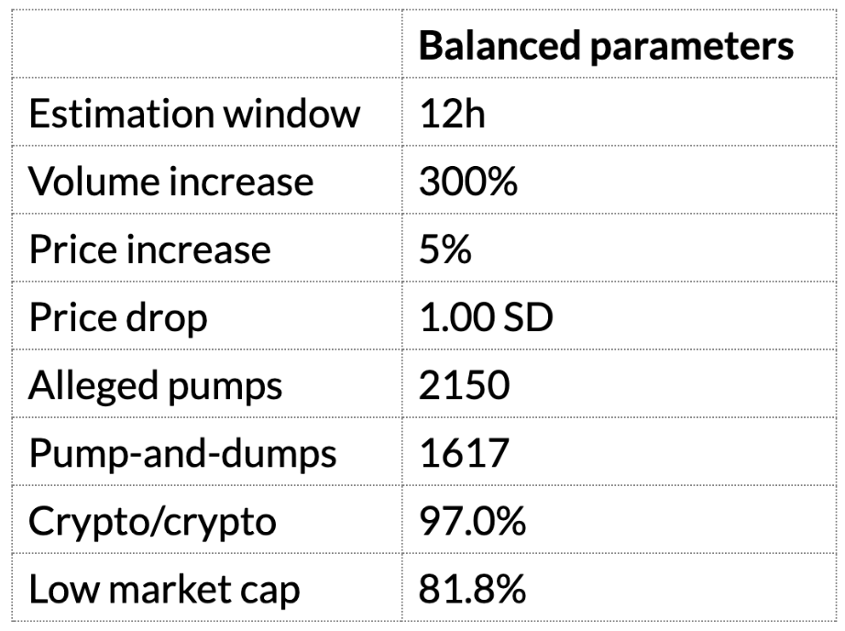
Anomaly Parameters

Slide 19
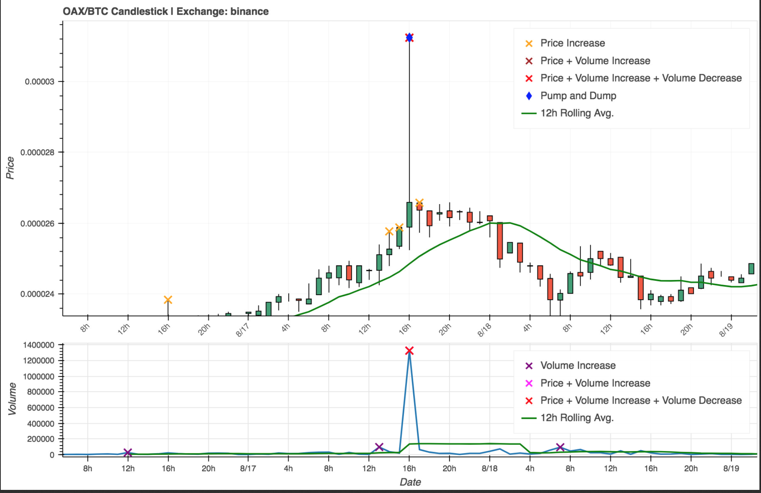
P&D Detection

Slide 20
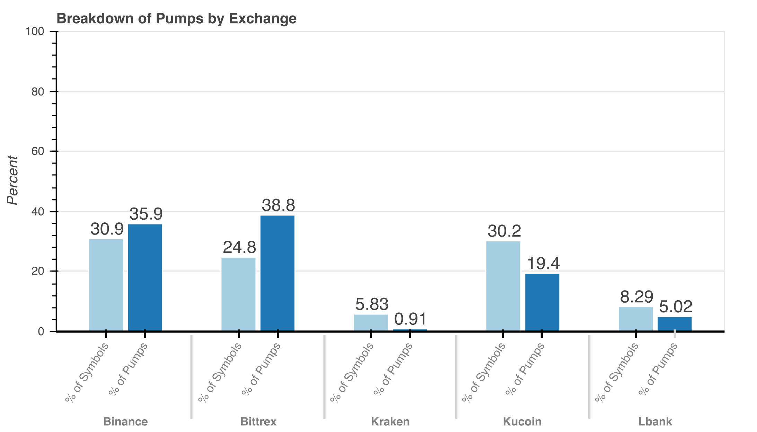
Zooming In: Exchange Level

Slide 21
Zooming in: Coin Level
Most are never targeted
Some are targeted again and again
30% of coins ∼ 80% of P&Ds

Slide 22
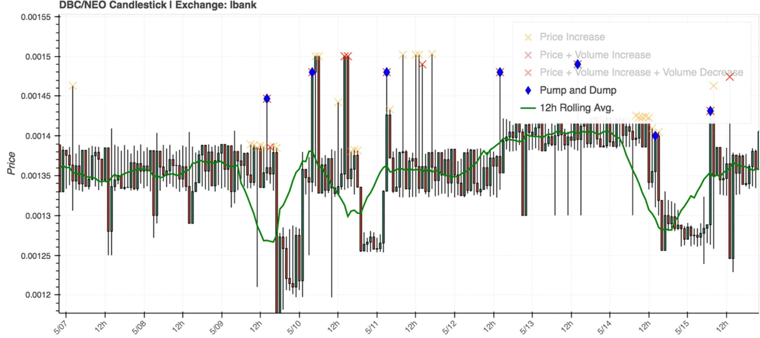
Repeat Victimisation

Slide 23
Core Findings
Potential for detectability
Targets are mainly crypto/crypto pairs
And mostly low market cap
Repeat exchange victimisation
Repeat coin victimisation

Slide 24
Further Context
P&D groups successful in pumping the price
(very) short timeframe
Telegram and Discord used for organising and coordination
see Kamps & Kleinberg, 2018; Xu & Livshits, 2018; Hamrick et al., 2018; Li et al., 2018

Slide 25
Maybe there’s more to the coins…
High-potential coins and coin malleability
Kamps & Kleinberg, forthcoming

Slide 26
Pick a coin to P&D
Arguably, the coins to choose are not random but rather are subject to a rational cost-benefit process
→
Manipulate as much as possible with as little as possible

Slide 27
Coin Malleability
“the percentage price increase that a coin would experience, with respect to a certain amount of volume injected”

Slide 28
Data
239 x/BTC pairs
scraped in April 2019
levels of BTC injection
0.25 BTC (~ $1,300)
1.00 BTC (~ $5,100)
5.00 BTC (~ $25,500)
10.00 BTC (~ $51,000)

Slide 29
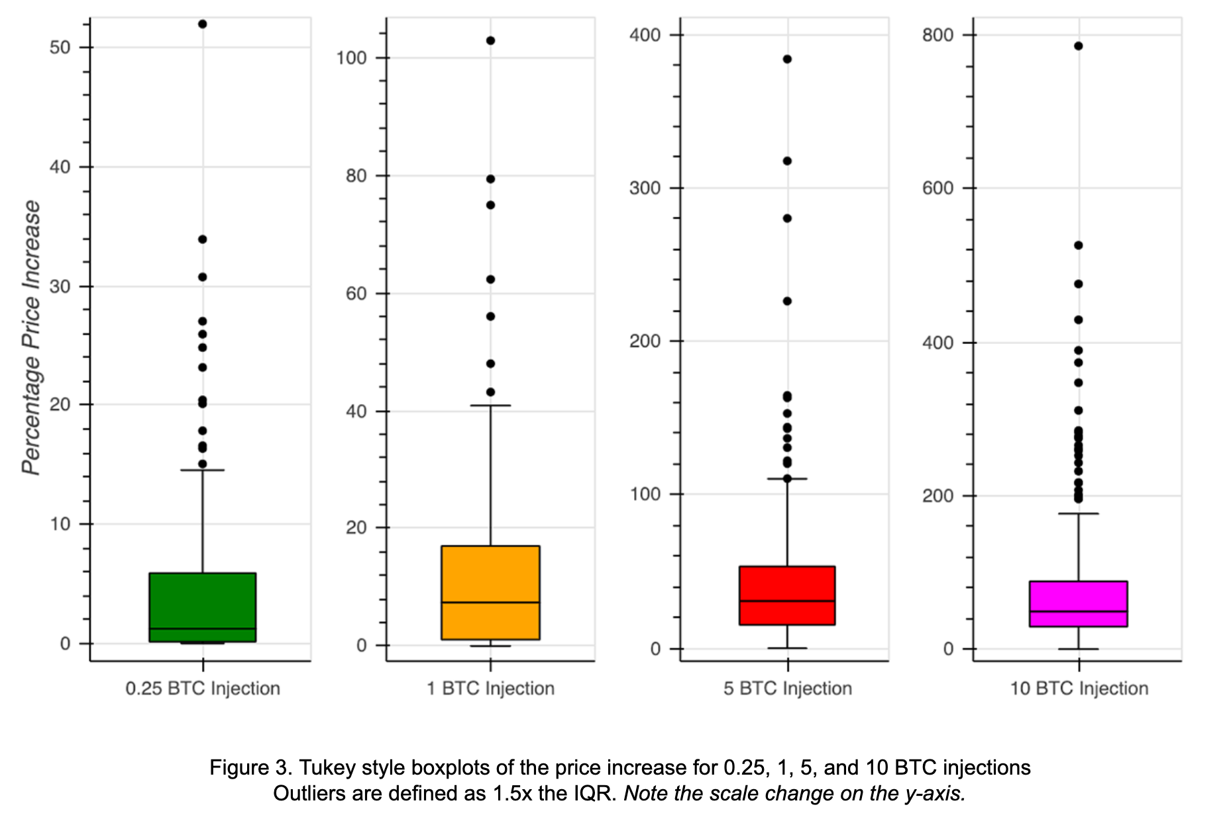

Slide 30
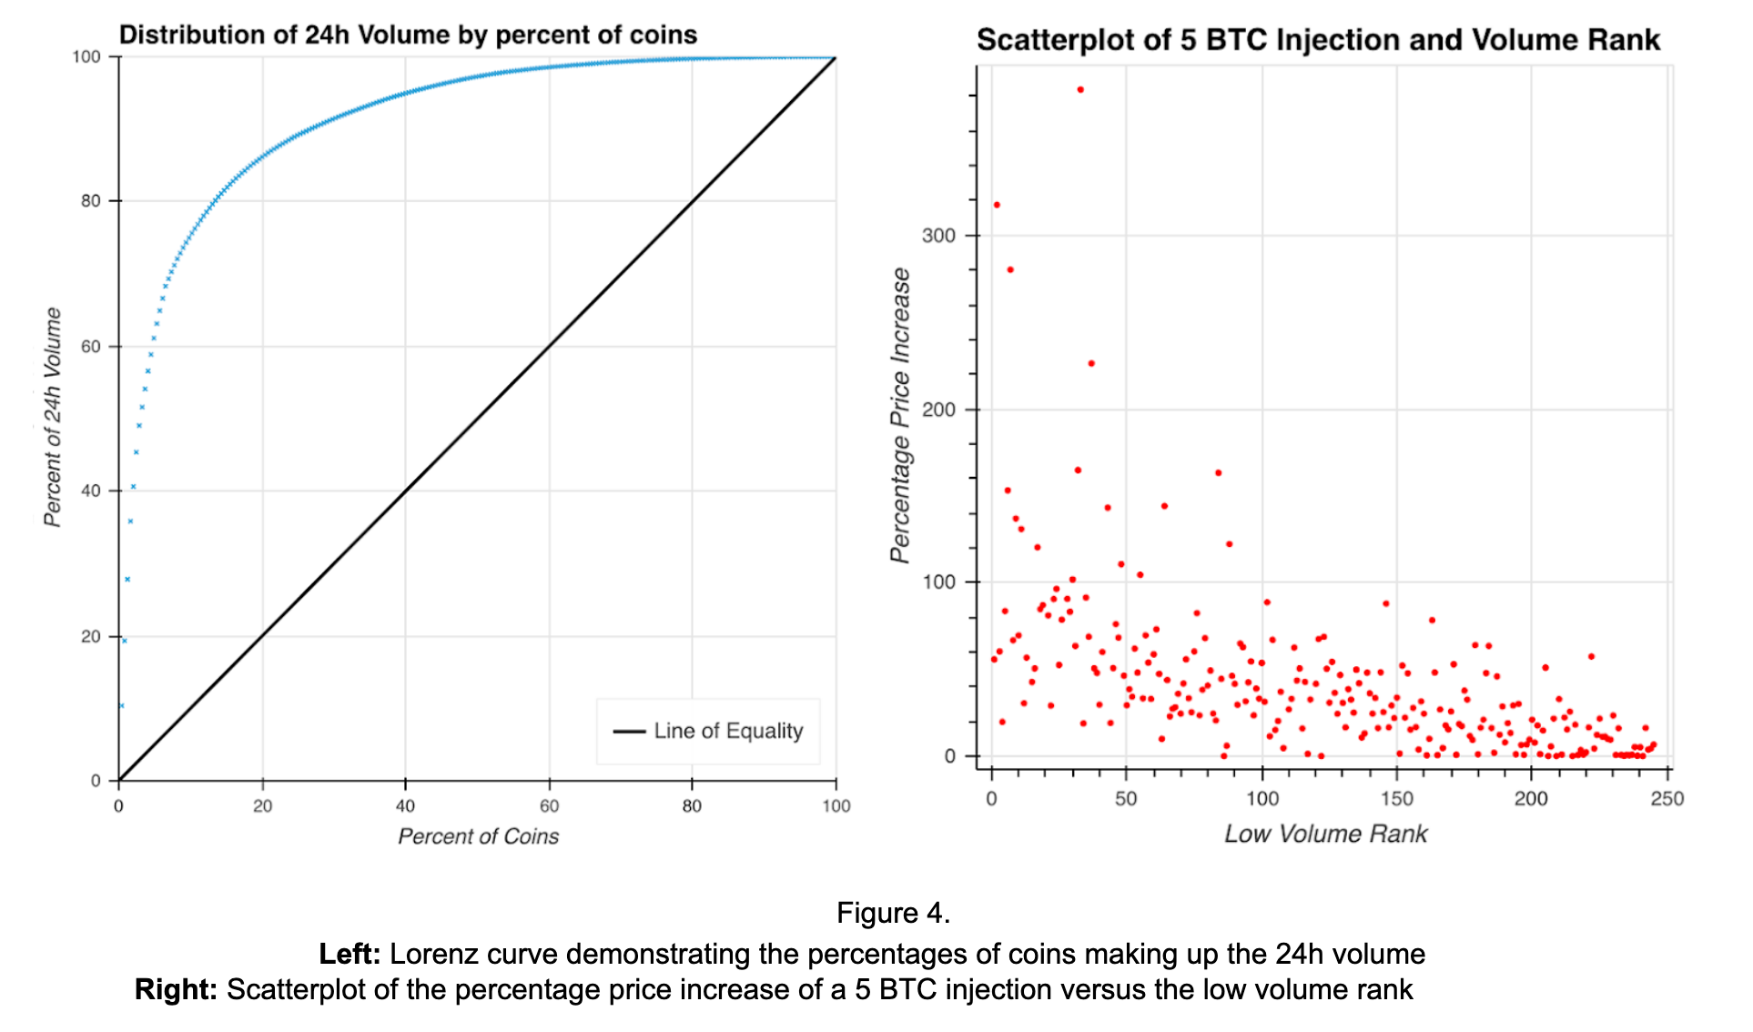

Slide 31
Core Findings
Not all coins are equal!
Some coins are more malleable than others
Trading volume highly clustered
Malleability not identical to low volume
Possible explanation: some volume is necessary for a good pump!
Good to know for prevention!

Slide 32
Other Fraud Types
(limited academic research)
Notes:
Lets now briefly divert to a couple other types of fraud

Slide 33
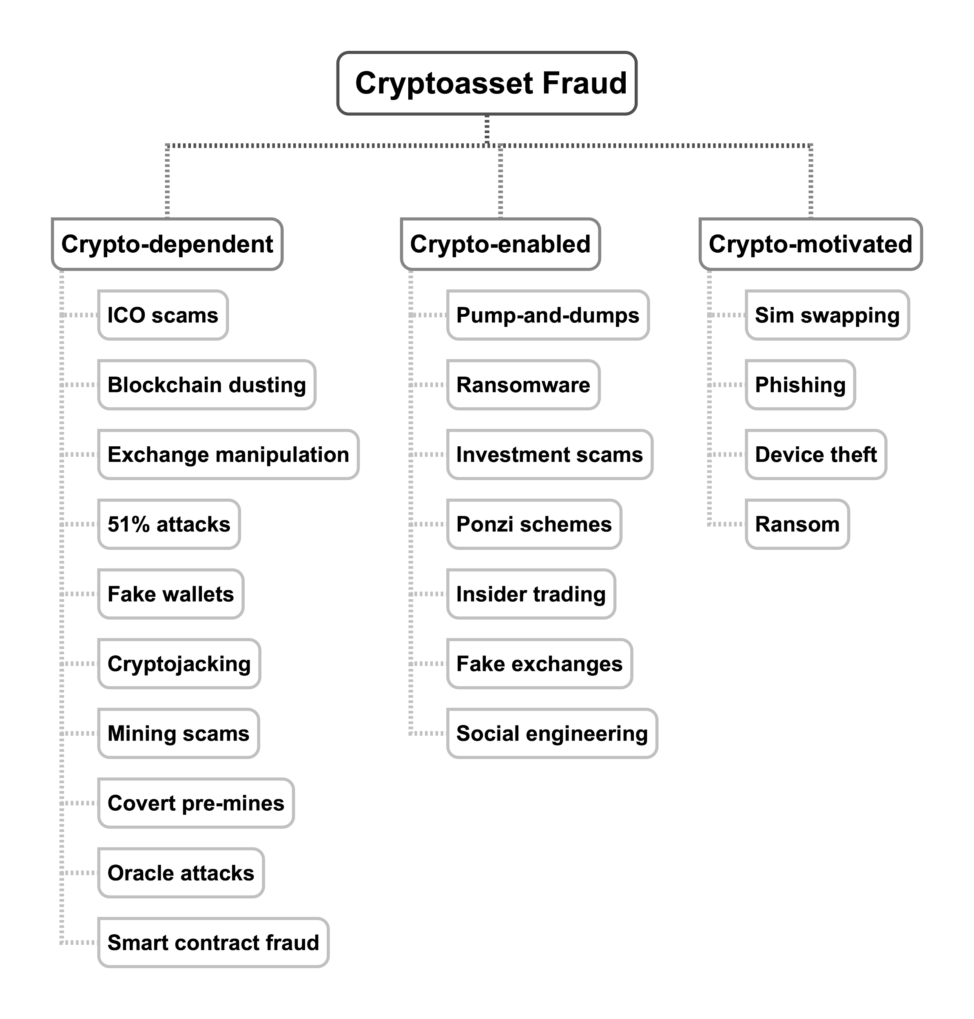
* Parent and children nodes are debatable in both name and placement.
Definition of ‘fraud’ is loose

Slide 34
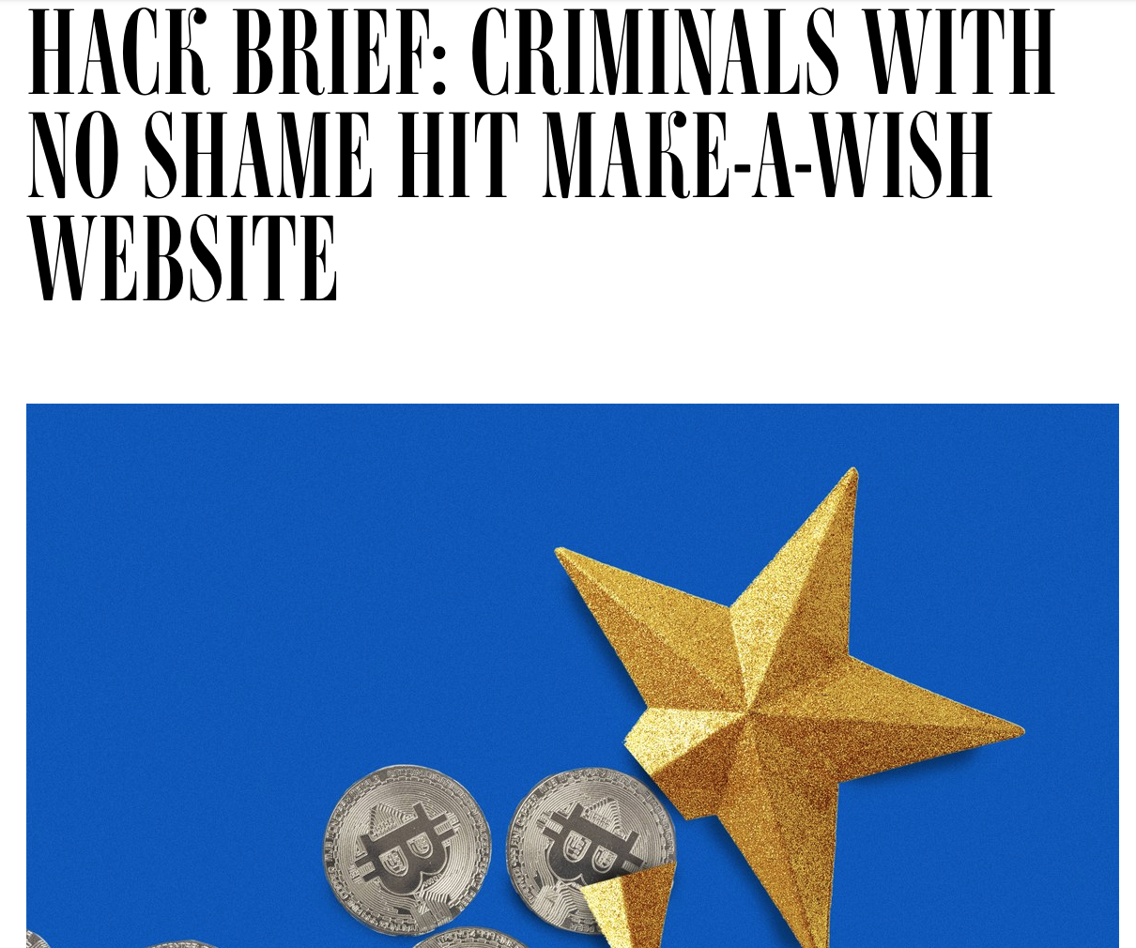
Cryptojacking
Unauthorised use of your computer to mine cryptocurrencies. Often while visiting websites.
Conservative estimate that 5% of all Monero (privacy crypto) was mined illicitly.
Source: Palo Alto Networks

Slide 35
Investment Scams
Scammers contact you and pitch you investment opportunities, posing as legitimate actors in the space.
Landscape is changing (e.g. cold calls vs online)
Sophisticated credentials
Usually some sort of time pressure
FCA reported 200 million pounds in damages last year with ‘cryptocurrencies’ being one of the top scams
Source: FCA

Slide 36

Sim Swapping
Get the phone company to issue a new SIM with someone elses phone number
Use this to break their 2-factor authentication
Great scam for crypto thanks to irreversibility
Recent scam job net scammers $2 million (and prison)
One individual lost $23 million
Notes:
Crypto is irreverisble

Slide 37
Scanning the Horizon
Convergence of variables =
New fraud tricks
New methods for old tricks
?
Internet
Real time communication
Lack of regulation
Cryptocurrencies
Decentralisation
?
?
?
Notes:
The convergence of many different regulatory, societal, and technological variables leads to new opportunities, and new types of fraud.

Slide 38
Conclusion
The landscape of cryptocurrencies is vast, volatile, and undefined. Smart solutions are needed to keep fraud in check, and help this sector reach its full potential.
Notes:
I hope with this have given a bit of insight into what some frauds look like, and what we may be able to do for prevention

